Slide 1

SPRINT 4
Olivia Bellino, Connor Bennett, Ludrianna Bazile

Slide 2

CHALLENGES WE FACED
During the sprints, many challenges arose.
Finding the correct speeds and times that the robot had to move while taking outside factors into account led to a trial and error process that challenged our code.
Another challenge that arose was the ability to collaborate. Although we solved this challenge fairly early in the process, we found it was necessary to fully understand and manage each other's thoughts because everyone’s ideas were necessary to complete the assignment.

Slide 3
ROLES OF EACH MEMBER
OLIVIA BELLINO-
-Project Manager
-Project managers play the lead role in planning, executing, monitoring, controlling and closing projects. They are accountable for the entire project scope, project team, resources, and the success or failure of the project.
CONNOR BENNETT-
-Documentation Manager
- A Documentation Manager plans and directs documentation projects for timely delivery of documents, publications, and online content. May act as final approver or editor for projects. Additionally, a Documentation Manager may require an associate degree or its equivalent.
LUDRIANNA BAZILE-
-Programmer Tester
-Organizing programs and activities in accordance with the mission and goals of the organization. Developing new programs to support the strategic direction of the organization. Creating and managing long-term goals. Developing a budget and operating plan for the program

Slide 4
WHAT WE HAVE LEARNED ABOUT SOFTWARE ENGINEERING
After the sprints were completed, as a whole, the group gained knowledge about the processes that go into software engineering.
There is a lot of trial and error incorporated into acquiring a working program and not everything is going to work perfectly the first time.
Team collaboration is also a key aspect within software engineering because problems become complex. With a group effort, these problems become easier and more understandable to solve.
A stable algorithm, collaboration, and trials all are key aspects that we learned during this project.

Slide 5
WHAT WE WOULD DO DIFFERENTLY
There are a few things we would do differently
Be more wary of time restraints
Attempt at better communication
Dedicate more time to planning
Work more on precision of the code
Set more time for the planning stage

Slide 6
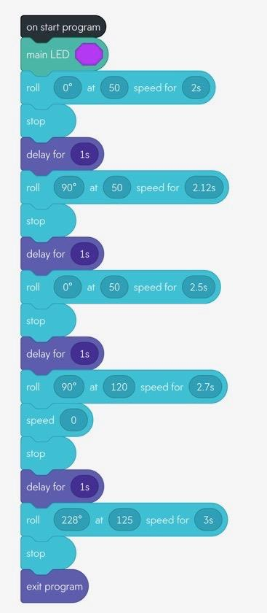
BLOCK CODE - SPRINT 3 AGILITY

Slide 7

VIDEO OF SPRINT 3 - AGILITY

